Slide 1
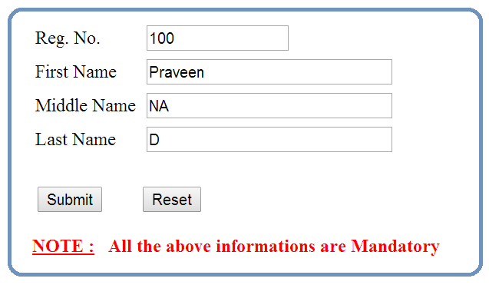

Slide 2
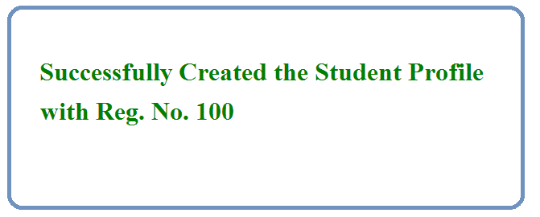


Slide 3
Java
JDBC
Driver
DB

Slide 4
Get
Reg. No., First Name,
Middle Name & Last Name information's via
Command Line Arguments
Java
JDBC
Driver
DB
1. Load the Driver
2. Get the DB Connection via Driver
3. Issue SQL Queries via Connection
insert into students_info values (?, ?, ?, ?)
4. Process the Results
Print Success / Error Message
5. Close All JDBC Objects

